Slide 1
Accessing MIDFIELD: A Workshop for R beginners
FIE 2019
Wednesday October 16, 2019 5 – 8 pm

Slide 2
Accessing MIDFIELD
Proportionately sampled dataset midfielddata on github
midfieldr package available for R to support analysis
https://midfieldr.github.io/midfieldr/
Getting Started tutorial, vignettes demonstrating special techniques/functions, data schema
Full MIDFIELD database available from Russell Long, confidentiality agreement required (protecting institutional identity)

Slide 3
Joining MIDFIELD
University-level administrators (Provost, Institutional Research, Registrar) sign MOU consenting to release de-identified student data
Institutional Research, Registrar, or data analysts working for the College of Engineering provide data in native format
Sign agreement to archive the data for research access
Submit undergraduate catalogs (pref. in electronic form).
Acquire IRB approval at your institution for your own research.

Slide 4
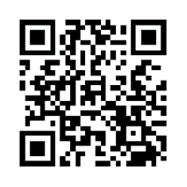

Find Out More
Email: midfield@purdue.edu
Phone: (765) 496-9521
Web: https://engineering.purdue.edu/MIDFIELD
Based on support from NSF award 1545667

